Slide 1
Simulating a Waterfall
CMP-6013Y Third Year Project
James Burrell 100263300

Slide 2
Problem Description and Solution
Computer graphics.
Simulating complex fluid movement presents many challenges.
Application in a wide variety of real-world problems.
Project aim.
Simulation of waterfall in typical ‘plunge’ topology.
Application developed with C++, OpenGL and GLSL.
Implemented following SPH methodology.

Slide 3
Implementation Background
Smoothed Particle Hydrodynamics (Gingold and Monaghan, 1977; Lucy, 1977).
Frequently used to model fluid movement.
Involves representing a fluid as collection of particles.
Movement was instead modelled on research into flow paths of real-life waterfalls.
Phong illumination model (Phong, 1975).
Lighting calculated dependent on a number of environmental factors.

Slide 4
System Testing and Results
Experiments to test impact on particle count and particle quality on system performance and visual accuracy.
Tests conducted on one PC so processing resources were the same in both sets of tests.
Dependent variables that gave quantifiable results:
1. Maximum frames rendered per second.
2. Peak memory usage.
3. Peak processor usage.
Dependent variables that gave subjective results:
1. Visual accuracy

Slide 5
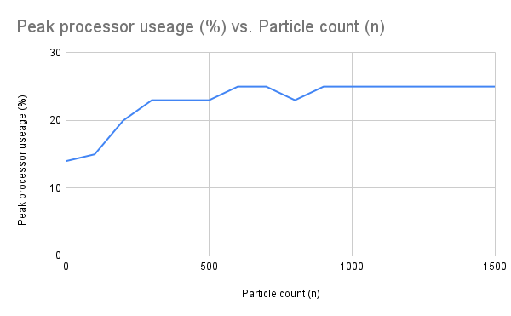
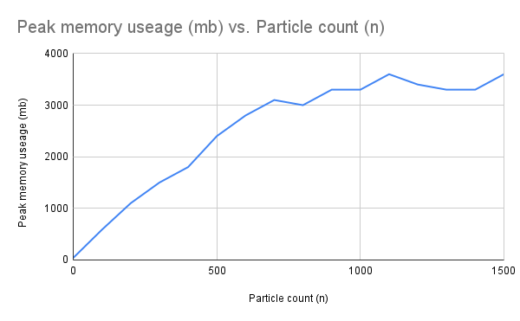
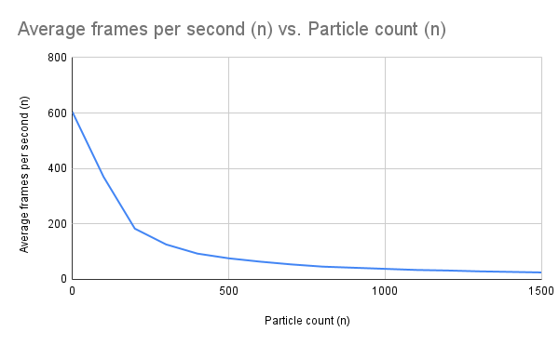
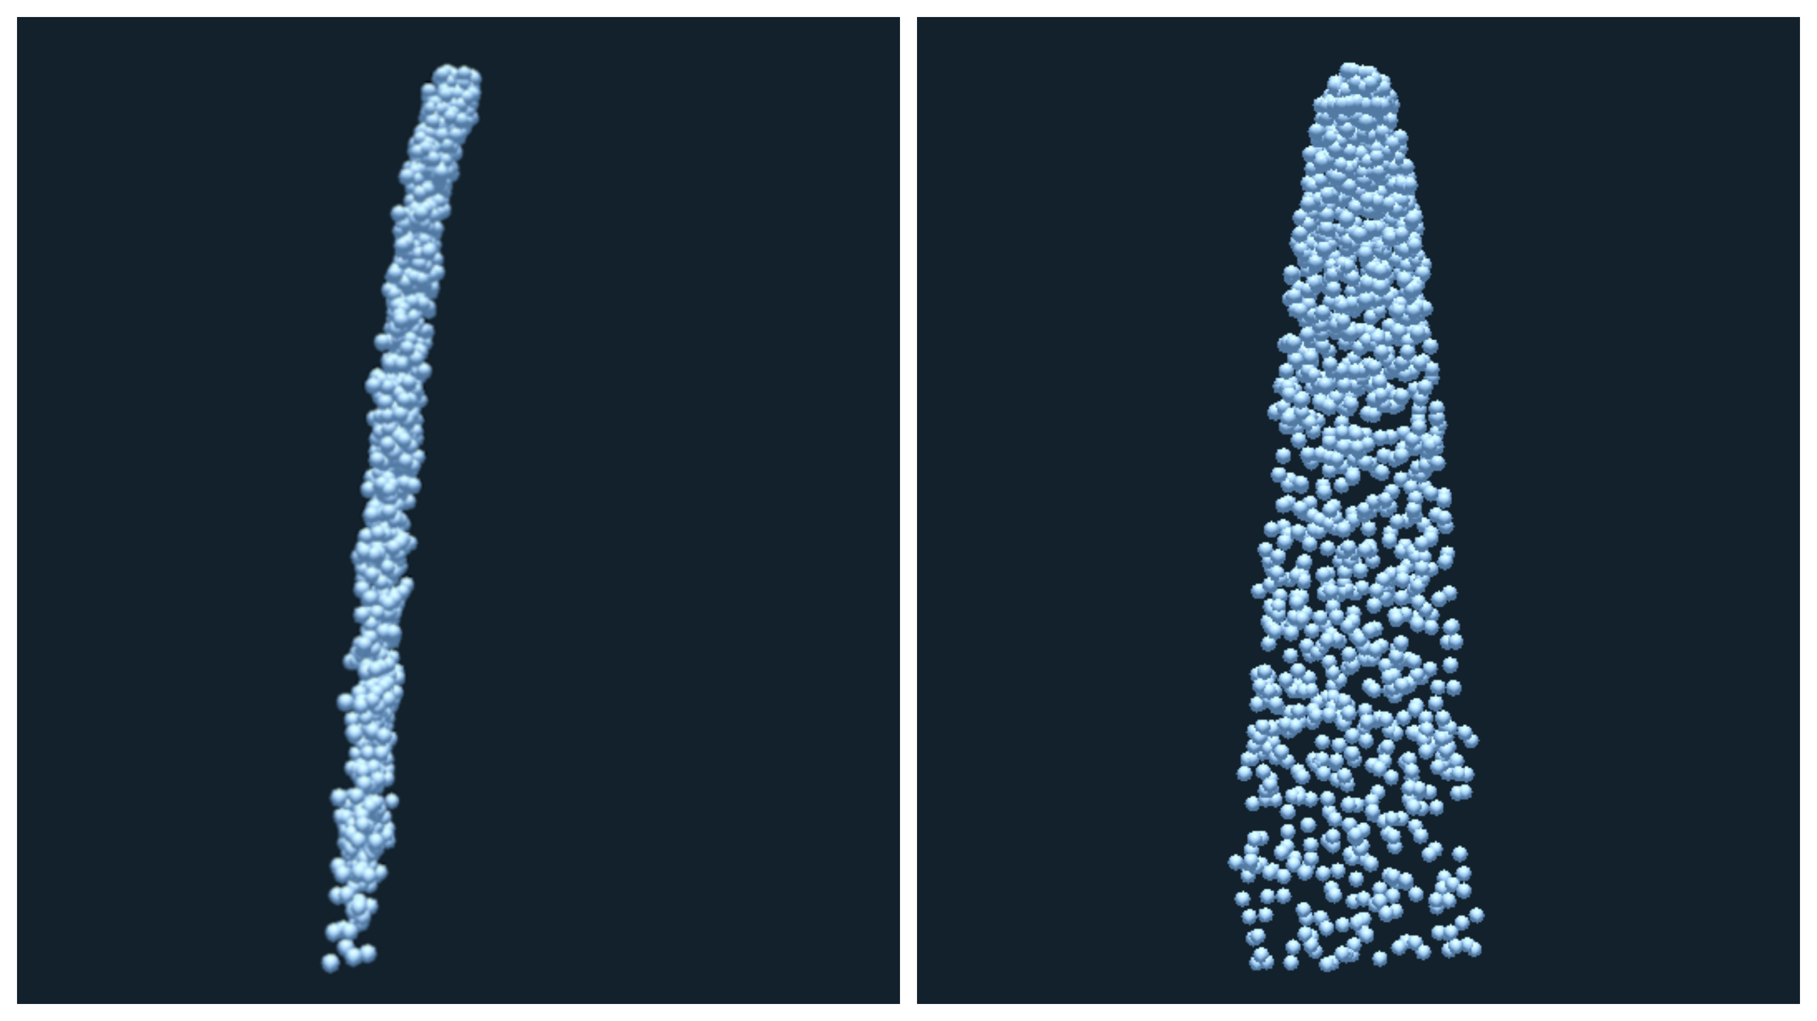
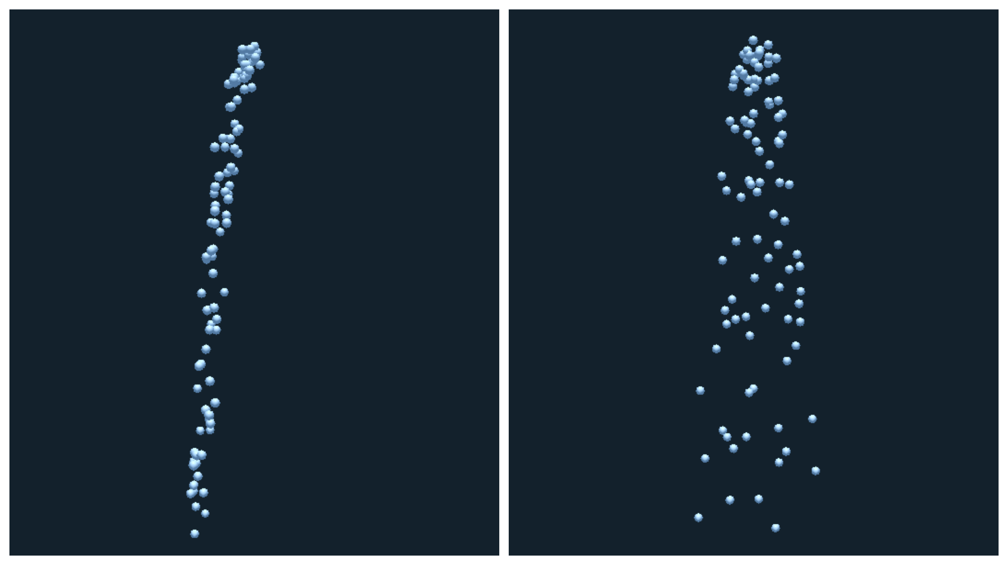

Slide 6
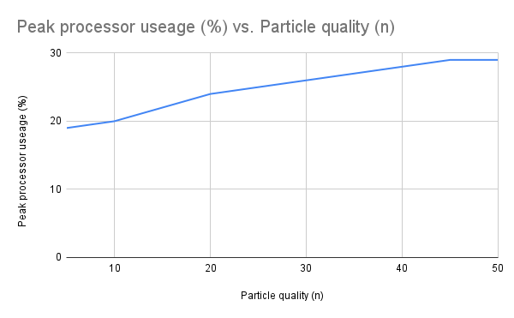
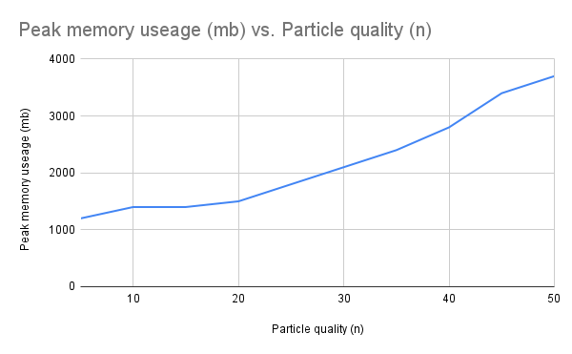
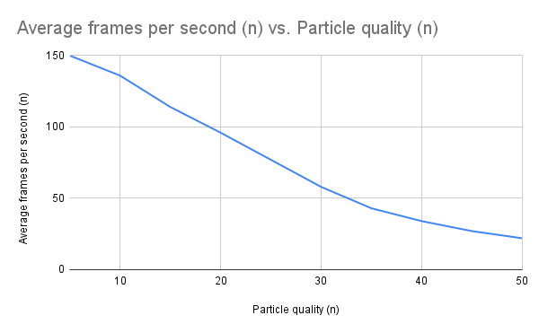
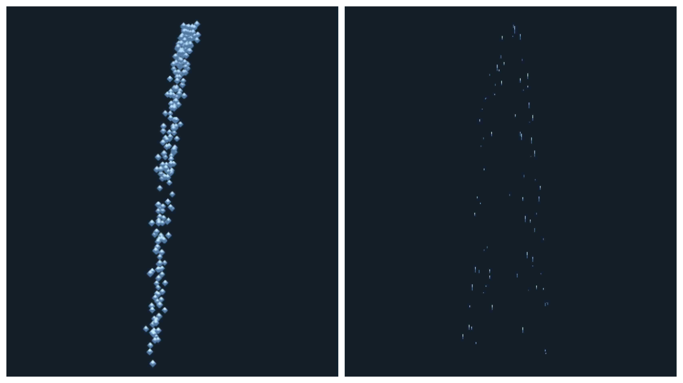
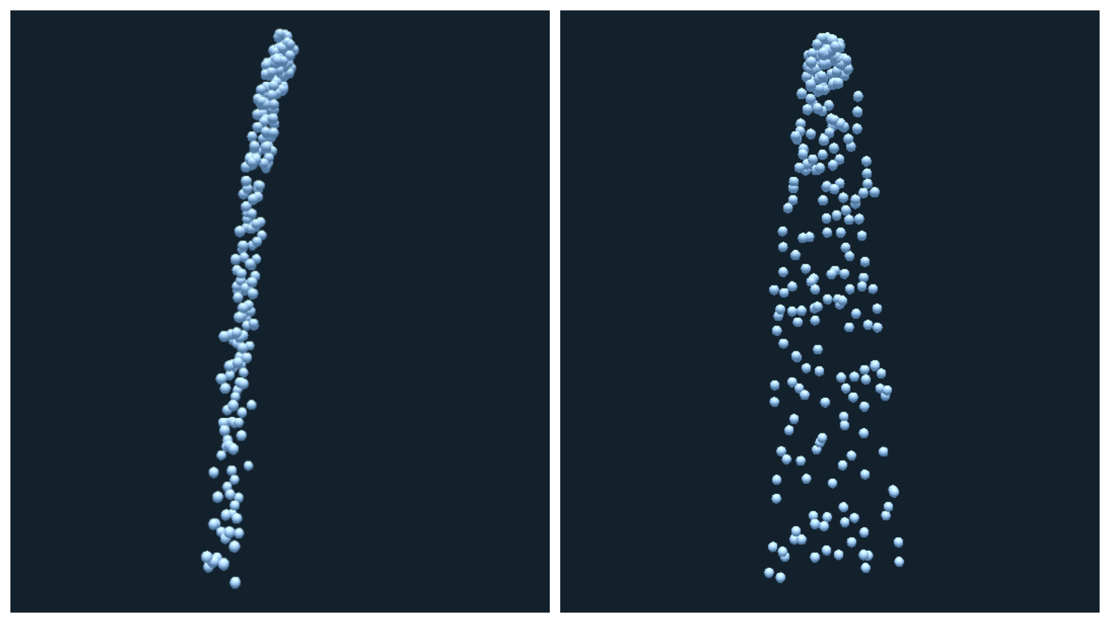

Slide 7
Program Demo
Note hardware differences between system used for testing and this demonstration.
 | Testing | Demonstration
CPU | Intel Core i7-6700k @ 4.0Ghz | Intel Core i7-7500u @ 2.70Ghz
GPU | Nvidia Geforce GTX 980Ti | Nvidia Geforce GTX 960M
Memory | 16.0GB DDR4 @ 2400 MHz | 16.0GB DDR4 @ 2133 MHz
Operating System | x64 Windows 10 | x64 Windows 10

Slide 8
Presentation References
Gingold, R.A. and Monaghan, J.J., 1977. Smoothed particle hydrodynamics: theory and application to non-spherical stars. Monthly notices of the royal astronomical society, 181(3), pp.375-389.
Lucy, L.B., 1977. A numerical approach to the testing of the fission hypothesis. The astronomical journal, 82, pp.1013-1024.
Phong, B.T., 1975. Illumination for computer generated pictures. Communications of the ACM, 18(6), pp.311-317.

